Slide 1

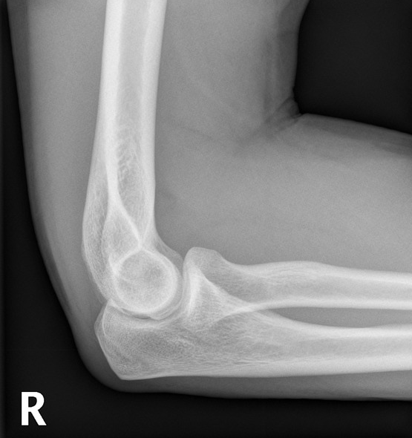

Elbow Anatomy
Mia Preece
m.preece1@londonmet.ac.uk

Slide 2
Overview
Bones and bony landmarks
Joints & their movements
Ligaments
Muscles
Nerves

Slide 3
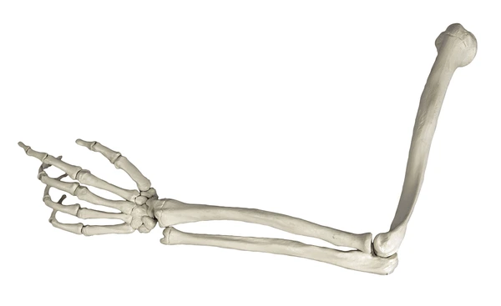
Bones of the Elbow Joint
Comprises of 3 bones
Humerus
Ulna
Radius
Humerus
Ulna
Radius

Slide 4
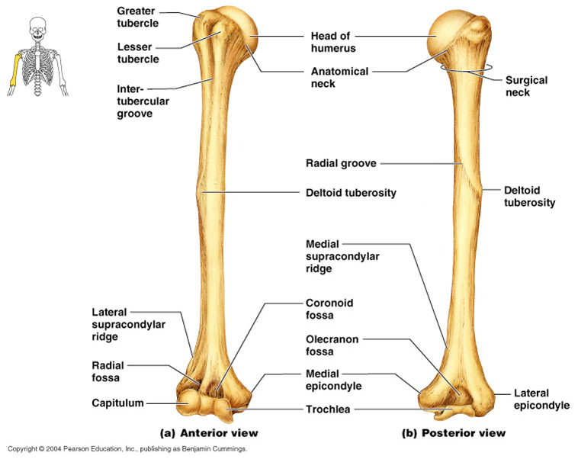
Bony Landmarks - Humerus

Slide 5
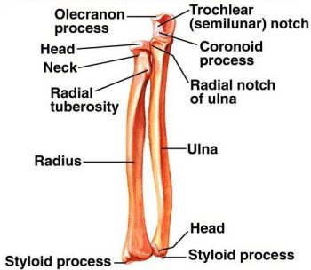
Bony Landmarks - Radius and Ulna
Radial head
Styloid process of radius
Styloid process of ulna

Slide 6
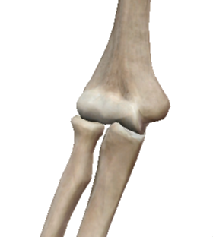
Articulations of the Elbow Joint
humerus
The 3 bones make up 3 joints of the elbow
Humero-ulnar joint
Humero-radial joint
Superior radio-ulnar joint
Humero-radial joint
radius
ulna
radius
Superior radio-ulnar joint
ulna
Humero-ulnar joint

Slide 7
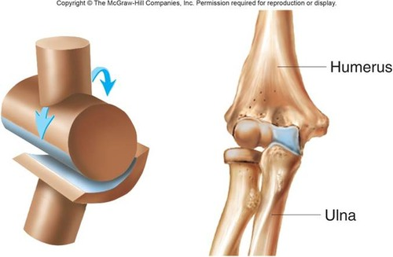
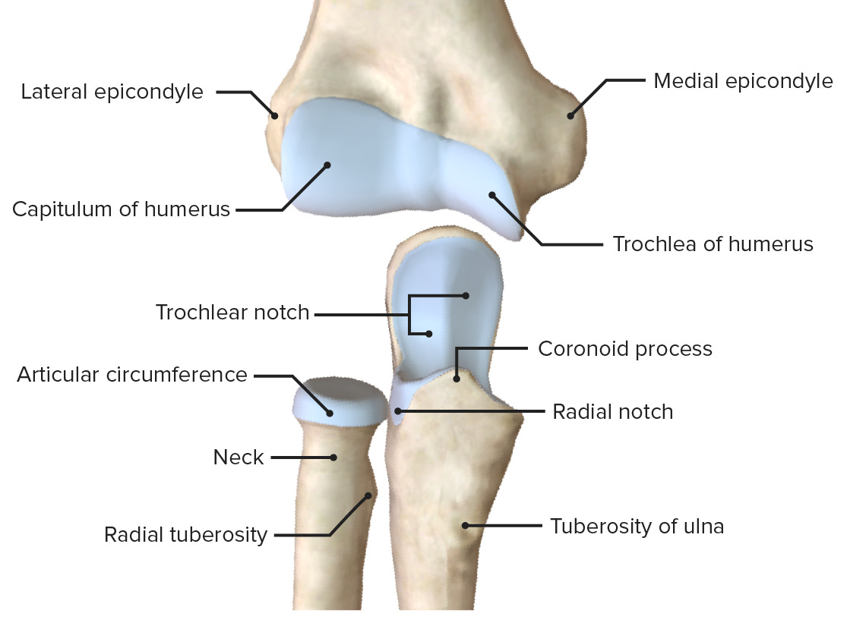
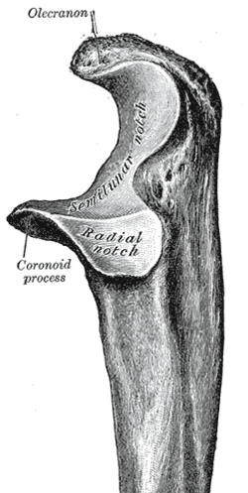
Humero-ulnar joint and Humero-radial joint
Classification: synovial hinge joint - uni-axial
Movements available: flexion / extension
Plane of movement: sagittal
Axis of movement : medial-lateral
Humero-ulnar joint articulation:
trochlea of humerus & trochlea notch of ulna
Humero-radial joint articulation:
capitulum of humerus and head of radius
Radial head

Slide 8
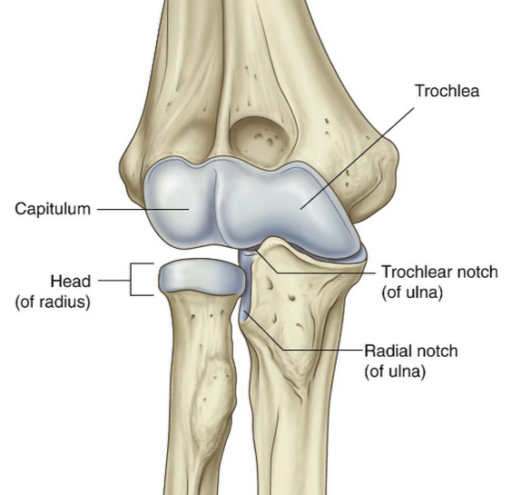
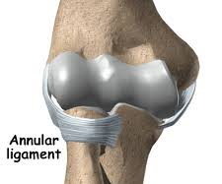
Superior (proximal) radio-ulnar joint
Classification: synovial pivot joint - uni-axial
Movements available: pronation / supination
Plane of movement: transverse
Axis of movement : superior-inferior
formed by the head of the radius and the radial notch (trochlea notch) of the ulna
- enclosed within the elbow joint capsule
Annular ligament encircles head of radius.
Strong fibrous ring that surrounds the
outside of radial head to prevent dislocation

Slide 9
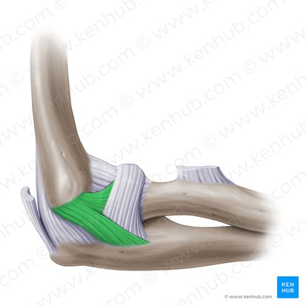
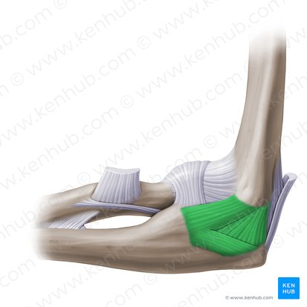
Stability: Ligaments
Lateral (radial) Collateral Ligament
- on lateral side
- strong band from lateral epicondyle to annular ligament
Role: resists varus force applied to joint
(forced adduction of forearm)
Medial (ulnar) Collateral Ligament
- on medial side
- 3 bands: anterior, posterior, intermediate (transverse)
- fan / triangular shaped arrangement
Role: resists valgus force applied to joint
(forced abduction of forearm)

Slide 10
Muscles acting over the elbow
Flexion: Biceps brachii (in supination)
Brachioradialis (in mid / functional position)
Brachialis (in pronation)
Extension: Triceps brachii & anconeus
Pronation: Pronator teres & pronator quadratus
Supination: Supinator & biceps brachii

Slide 11
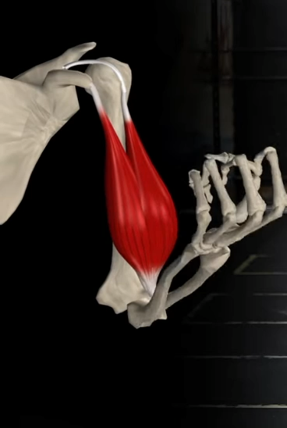
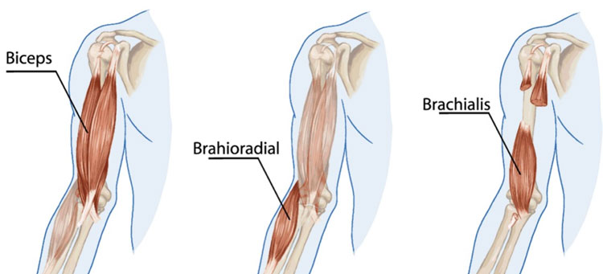
Flexors
Biceps brachii - flexor with hand supinated (shoulder)
O: long head - supraglenoid tubercle of scapula
short head - coracoid process of the scapula
I: radial tuberosity
Brachioradialis - flexor with hand in mid prone
O: lateral humerus
I: radial styloid process
Brachialis - flexor with hand in prone
O: mid anterior border of humerus
I : coronoid process

Slide 12
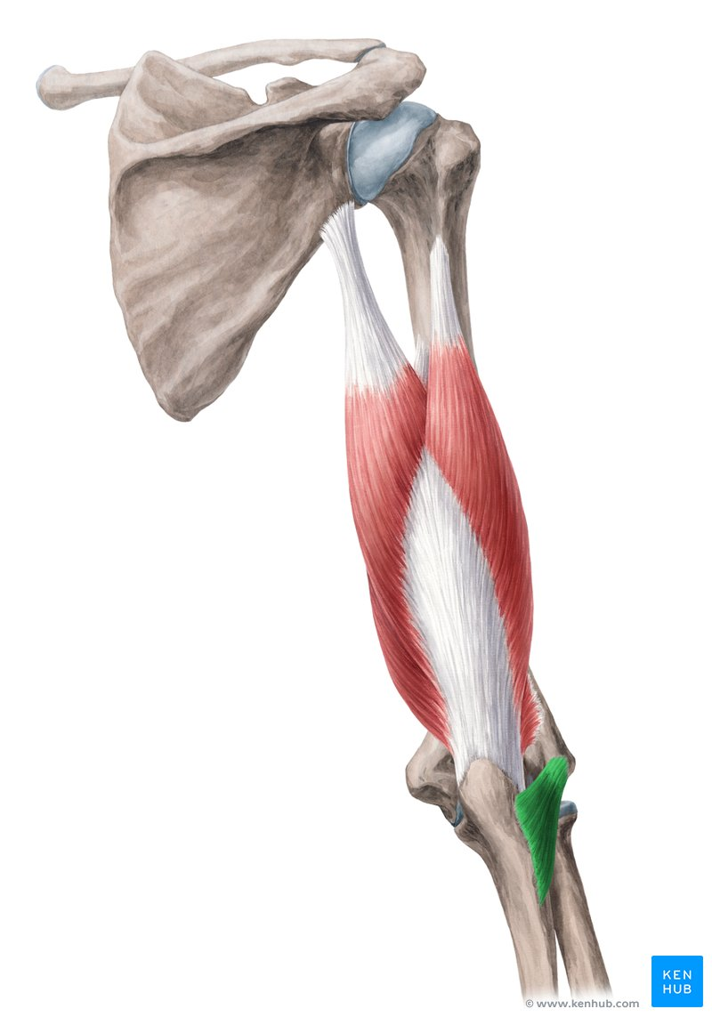
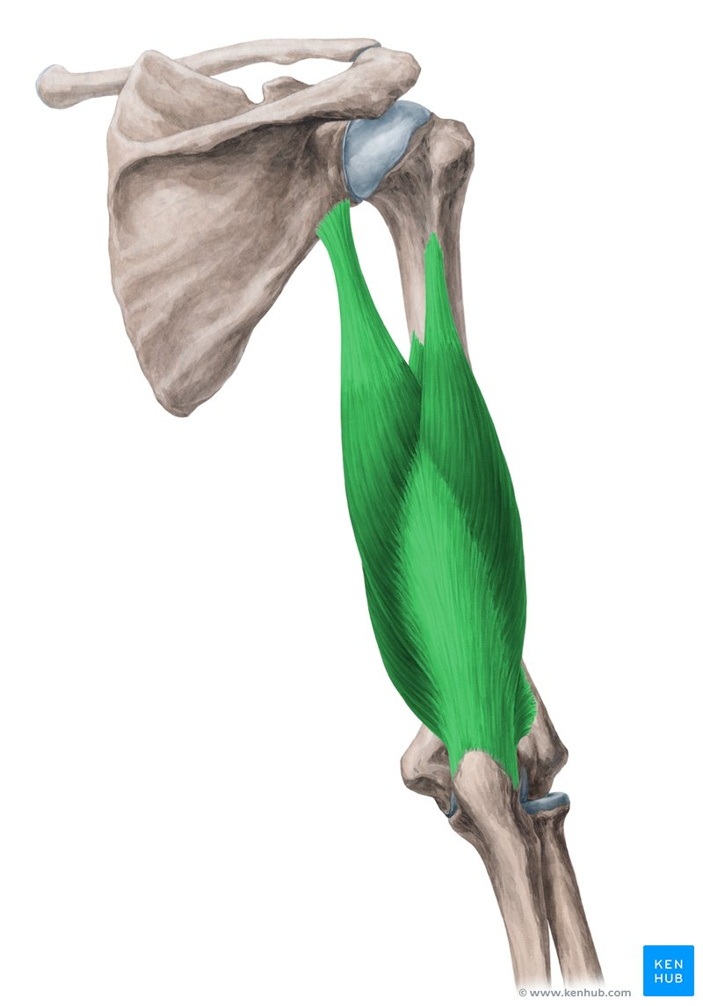
Extensors
Anconeus
- assists elbow extension
O: dorsal side of the lateral epicondyle of humerus
I: olecranon of the ulna
Triceps brachii (in shoulder lecture)
- main extensor muscle of the elbow
O: long head - infraglenoid tubercle of the scapula
lateral head - humerus (superior to radial groove)
medial head - humerus (inferior to radial groove)
I: distally, the heads converge into one tendon which
inserts onto the olecranon of the ulna
anconeus

Slide 13
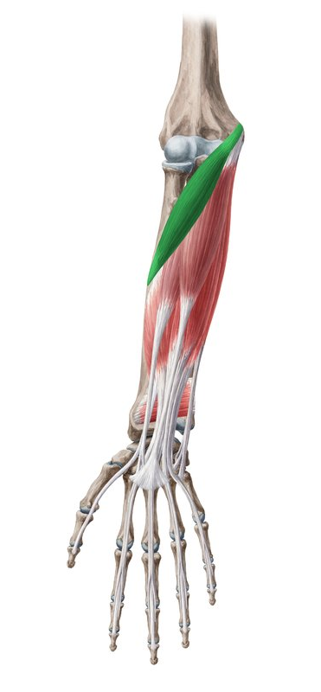
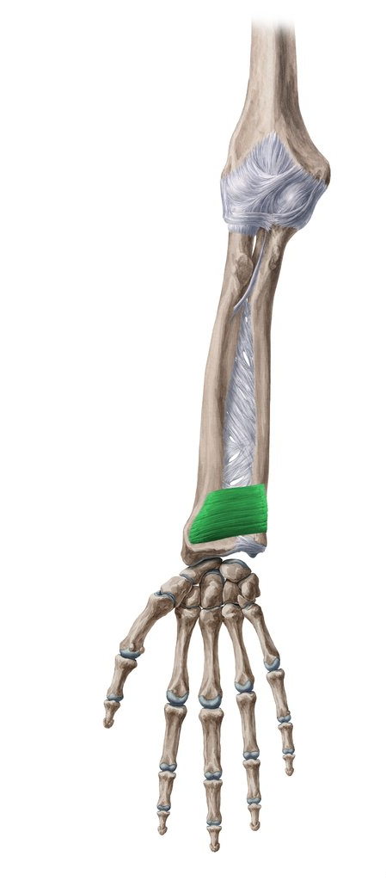
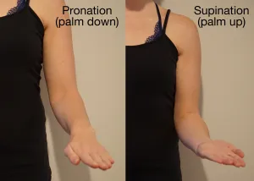
Pronators
Pronator teres
Anterior view
Pronator teres
O: medial epicondyle and coronoid process
I: lateral border of radius (mid shaft)
Pronator quadratus
O: distal medial border of ulnar
I: distal lateral border of radius
Pronator quadratus

Slide 14
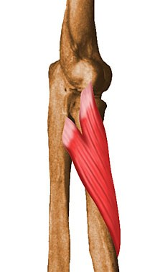
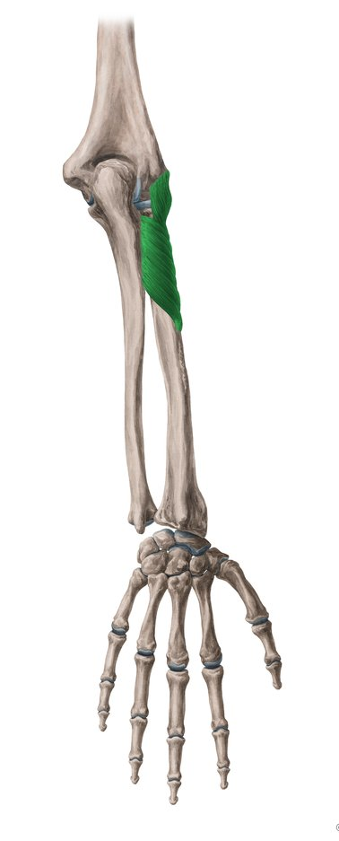
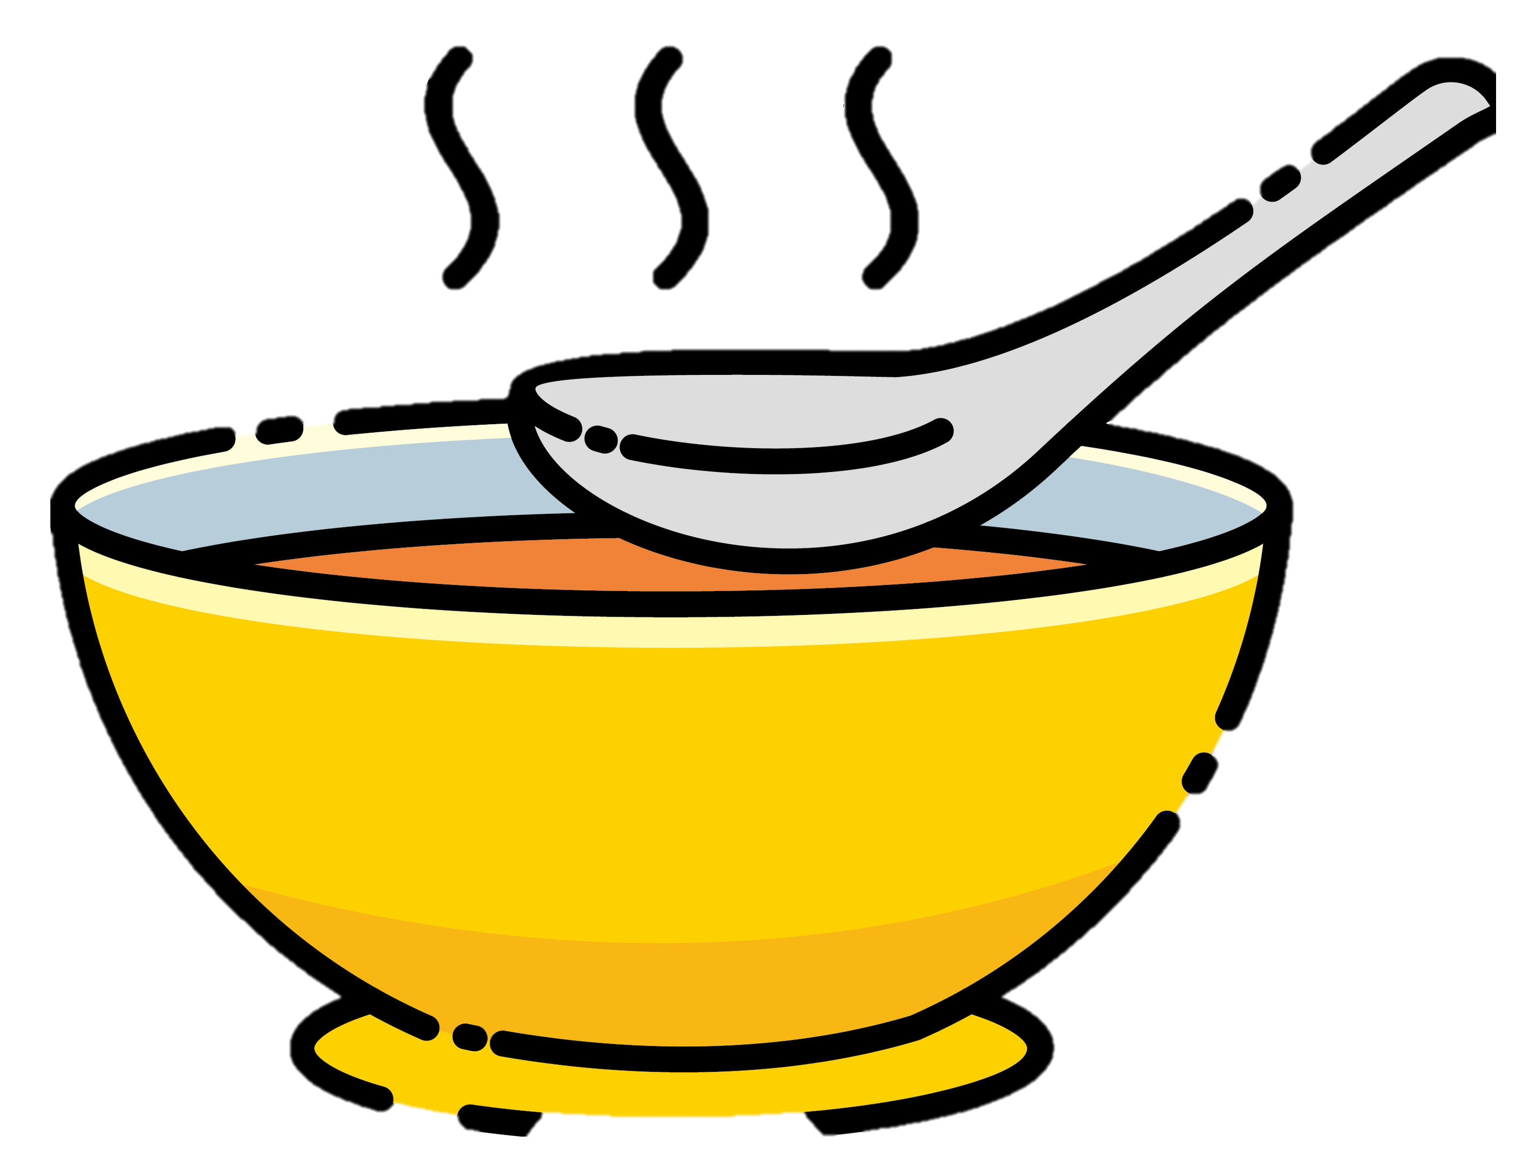
Supinator
Posterior view
Supinator
O: Lateral epicondyle of the humerus,
posterior part of the ulna, radial collateral
ligament & annular ligament
I: Lateral and dorsal surface of the upper
third of the radius
GOOD SOUP!

Slide 15
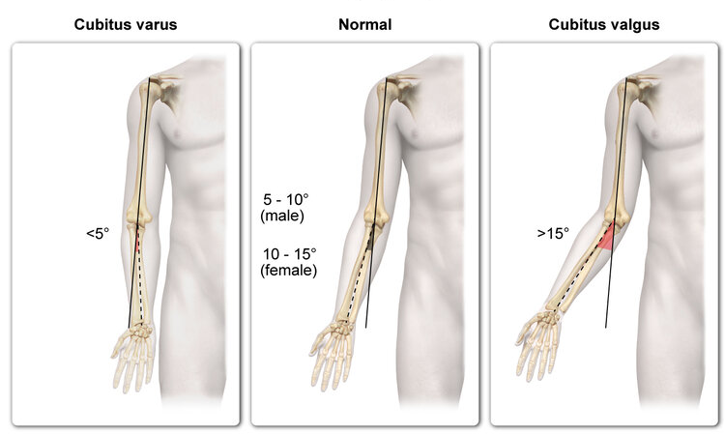
Function: The Carrying Angle
Carrying angle is an acute angle formed between the arm and forearm when in the anatomical position
Joint between humerus & radius/ulna form an angle usually between 5-15°
Male / female difference - why?
- same angle before puberty
Evolutionary reasons:
  - arms clear the hips when walking
  - carrying a child

Slide 16
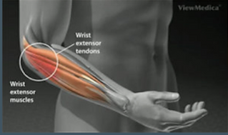
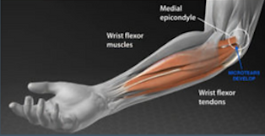
Common Elbow Injuries
Lateral Epicondylitis (Tennis Elbow)
inflammation of the origin of the extensor carpi radialis brevis on the lateral epicondyle
overuse injury from wrist extension
Medial Epicondylitis (Golfer’s Elbow)
tendinosis of the medial common flexor tendons at the common attachment site (enthesis)
overuse or repetitive injury from flexion and pronation

Slide 17
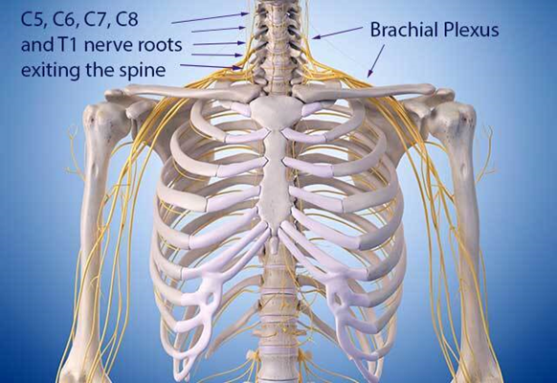
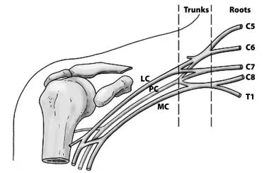
Innervation - Brachial Plexus
(relates also to shoulder)
The brachial plexus is a bundle of nerves that stems from nerve roots in the cervical and upper thoracic sections of the spinal cord (C5-T1), creating a network that connects to the nerves in the arm.
Responsible for cutaneous and muscular innervation of the entire upper limb.
Medial cord, lateral cord, posterior cord.

Slide 18
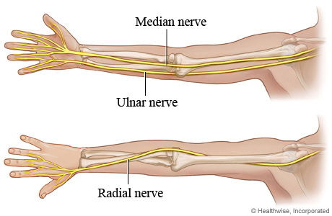
Median Nerve
Roots: C6 - T1
(from the medial and lateral cords of the brachial plexus)
Motor Functions: innervates most of the muscles in the anterior forearm, and some intrinsic hand muscles
Sensory Functions: comes off the palmar cutaneous branch, which innervates the lateral aspect of the palm, and the digital cutaneous branch, which innervates the lateral three and a half fingers on the anterior (palmar) surface of the hand

Slide 19
Ulnar Nerve
Roots: C8 - T1
(from the medial cord of the brachial plexus)
Motor Functions: innervates the muscles of the hand, flexor carpi ulnaris and medial half of flexor digitorum profundus
Sensory Functions: innervates the anterior and posterior surfaces of the medial one and half fingers, and associated palm area

Slide 20
Radial Nerve
Roots: C5 - T1
(from the posterior cord of the brachial plexus)
Motor Functions: innervates the triceps brachii, and the extensor muscles in the posterior compartment of the forearm
Sensory Functions: innervates the posterior aspect of the arm and forearm, and the posterior, lateral aspect of the hand

Slide 21
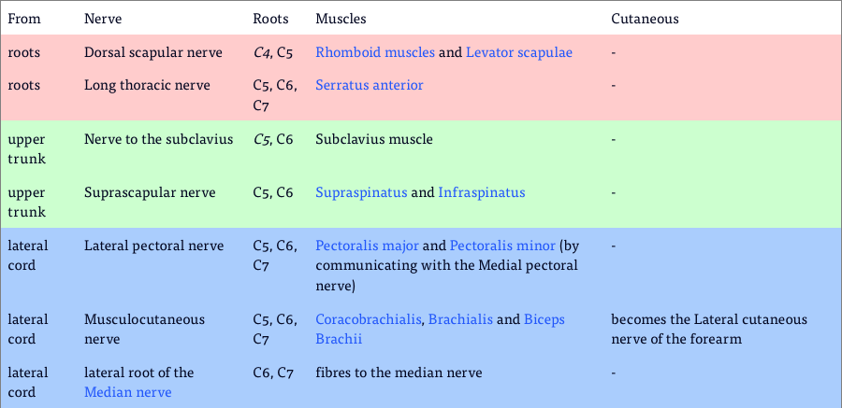
Brachial Plexus branches and innervations
(relates also to shoulder)
continued…

Slide 22
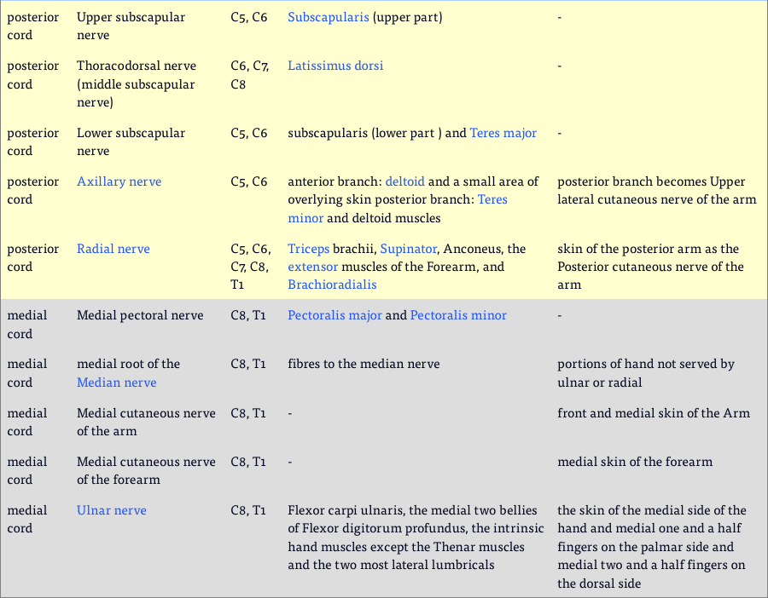

Slide 23
Self-assessment questions
Describe the three main bones that form the elbow joint and their anatomical relationships.
What are the primary movements allowed by the elbow joint, and which muscles are responsible for these movements?
Explain the role of the ulnar collateral ligament and the radial collateral ligament in stabilising the elbow.
What is the function of the annular ligament, and how does it contribute to forearm rotation?
Identify the origins, insertions, and actions of the biceps brachii and triceps brachii in relation to elbow movement.
What is the carrying angle of the elbow, and why is it important in human biomechanics?
Describe the articulations at the elbow joint and classify them based on joint type.
What is "tennis elbow" (lateral epicondylitis), and which anatomical structures are primarily affected?
Thank you for listening!

